Slide 1



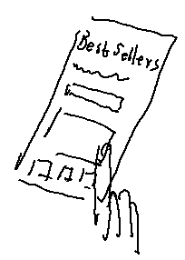
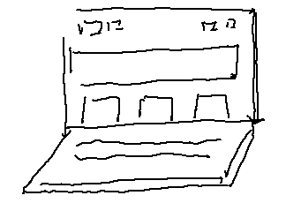
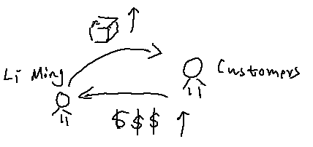
UX Design Storyboard
Scenario: Utilize the Amazon Best Seller App to identify the top-selling products specifically catered to Amazon business professionals. –big picture
Li Ming frustrated with finding the top-selling products on Amazon.
Li Ming downloads Amazon Best Seller App and opens it.
Li Ming is happy that the app is screen reader friendly.
Li Ming finds the lists of best sellers.
Li Ming picked the products for her Amazon business website.
Li Ming sells products to customers all over the world and makes a fortune .

Slide 2
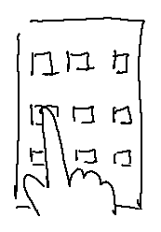

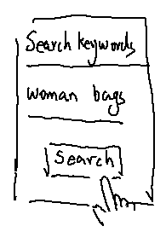
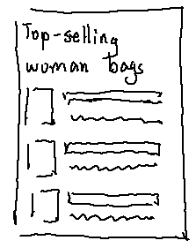
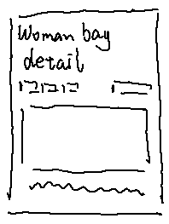
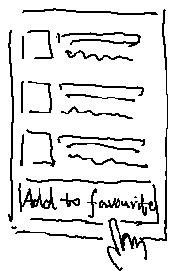
UX Design Storyboard
Scenario: Utilize the Amazon Best Seller App to identify the top-selling products specifically catered to Amazon business professionals. –close-up
Li Ming downloads the app and opens the app.
Li Ming is welcomed on the homepage.
Li Ming is searching the top-selling woman bags.
Li Ming gets a list of top-selling woman bags.
Li Ming reads the detail of some woman bag.
Li Ming adds the list of top-selling woman bags to her favourites.

